Slide 1
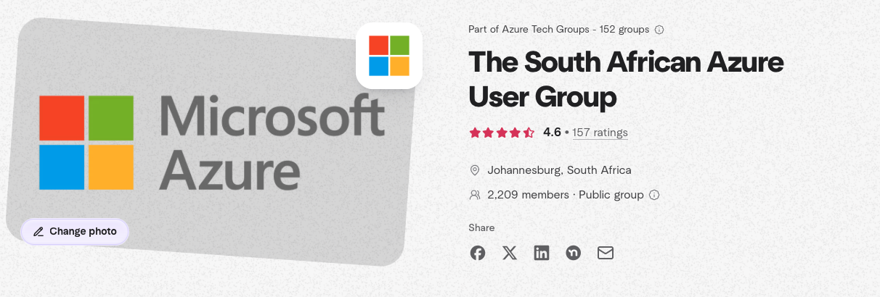
2213

Slide 2
Week 44 of 2025 –in Azure Lunch and learn
www.meetup.com/azure-user-group-southafrica
Monday, Oct 27 · 12:00 PM to 1:00 PM SASTVS Code for IT Admins: Exploring and Managing Azure Without Being a Developer - Matthew Levy
Tuesday, Oct 28 · 12:00 PM to 1:00 PM SAST
Data Deep Dive: Selecting the Right Azure Data Architecture - Ian van Niekerk
Wednesday, Oct 29 · 12:00 PM to 1:00 PM SAST
Entra Suite: The Good, The Bad, and The Ugly - Shaun Hardneck
Thursday, Oct 30 · 12:00 PM to 1:00 PM SAST
Azure Network: Choosing the Right Connectivity Architecture for Your Cloud - Warren du Toit

Slide 3
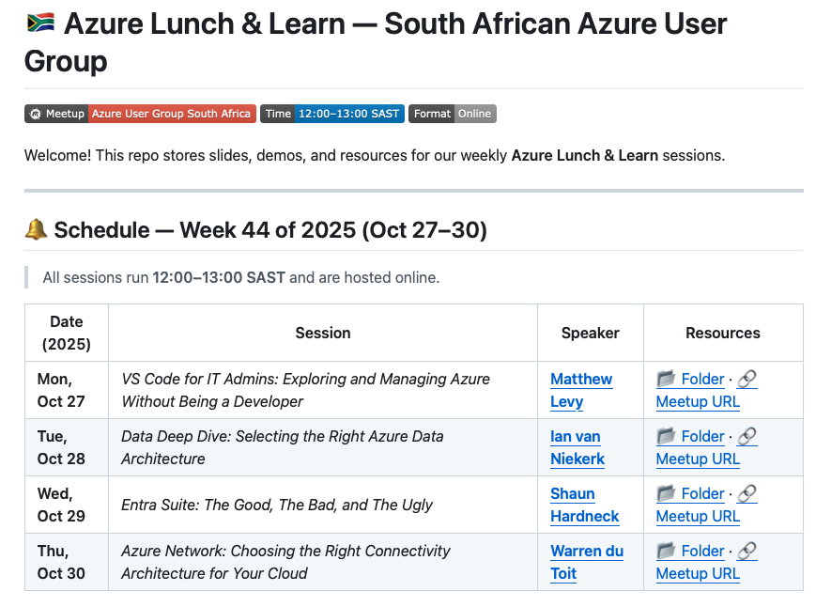
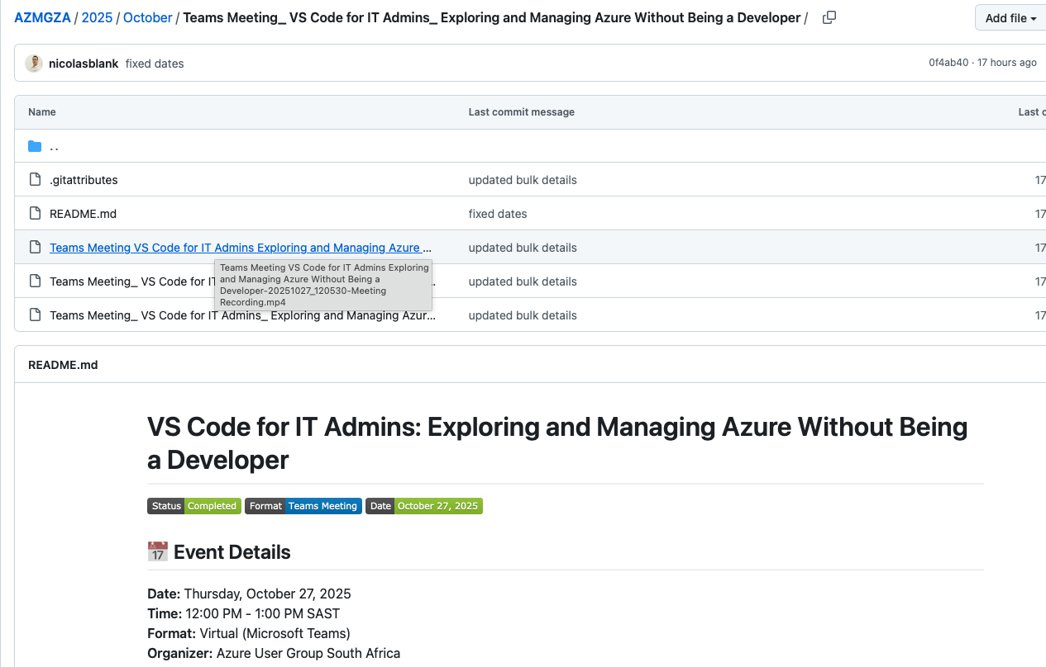
If you miss a session – don’t fear
github.com/nicolasblank/AZMGZA

Slide 4
Code of Conduct
This is a group for anyone interested in Cloud computing, with a specific focus on Microsoft's Azure platform We aim to connect and grow people with similar interests (the Azure platform and accompanying services) to connect and develop their knowledge by sharing experiences.
The South African Azure User Group is dedicated to empowering every person and every organization on the planet to achieve more. We seek to provide a respectful, friendly, professional experience for everyone, regardless of gender, sexual orientation, physical appearance, disability, age, race or religion. We do not tolerate any behavior that is harassing or degrading to any individual, in any form. Individuals are responsible for knowing and abiding by these standards. We encourage everyone to assist in creating a welcoming and safe environment.
Please report any concerns, suspicious or disruptive activity or behavior to the Organisers.
The South African Azure User Group reserves the right to refuse admittance to or remove any person from the usergroup at any time at its discretion.

Slide 5

About:Matt Levy
With over 8 years in IT consulting, I am dedicated to advancing secure identity and authentication practices. Recognized as a Microsoft MVP for Security, my passion lies in enabling teams to achieve operational excellence while sharing insights on identity governance and application security through technical blogs and community engagement.
Solutions Architect at Threatscape
www.linkedin.com/in/mattlevy42
X/Twitter: @mattchatt42

Slide 6
Azure lunch and Learn
VS Code for IT Admins: Exploring and Managing Azure Without Being a Developer
Solutions Architect at Threatscape
https://www.linkedin.com/in/mattlevy42/
X/Twitter: @mattchatt42

Slide 7


About:Ian van Niekerk
Experienced Data professional with a demonstrated history of working in various sectors. Skilled in Business Analysis, Data Engineering, Business Intelligence, and Data Architecture with a Masters in Information Technology in the field of Big Data Science
Head Data Consultant at Datageek
www.linkedin.com/in/ian-van-niekerk-7a241415

Slide 8

Azure Lunch and Learn
Data Deep Dive: Selecting the Right Azure Data Architecture
Head Data Consultant at Datageek
www.linkedin.com/in/ian-van-niekerk-7a241415
ian@datageek.co.za

Slide 9
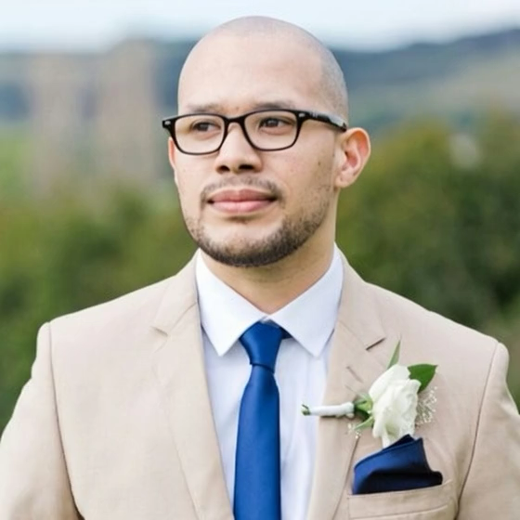
About: shaun hardneck
As a seasoned Cloud Architect, I specialize in harnessing the full potential of Microsoft Azure and Microsoft 365 ecosystems to deliver secure, scalable, and innovative cloud solutions. With years of hands-on experience, I’ve designed, deployed, and optimized robust cloud infrastructures that empower businesses to achieve greater operational efficiency and security.
Microsoft Certified | Azure & Microsoft 365 Security Architect | Cloud Infrastructure Specialist www.linkedin.com/in/shaunhardneck

Slide 10
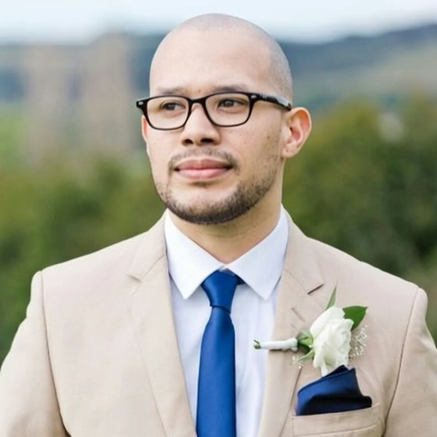
Azure Lunch and Learn
Entra Suite: The Good, The Bad, and The Ugly
Microsoft Certified | Azure & Microsoft 365 Security Architect | Cloud Infrastructure Specialist www.linkedin.com/in/shaunhardneck
Blog link: www.thatlazyadmin.com

Slide 11
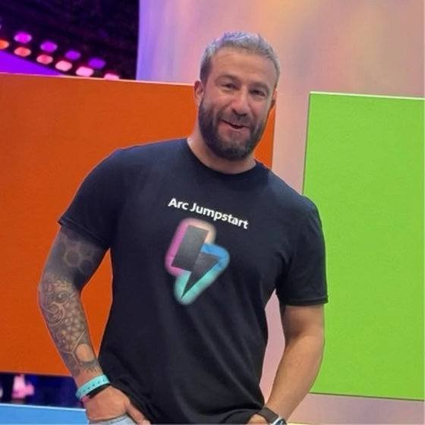
About: Warren du Toit
As a seasoned Cloud Architect, I specialize in harnessing the full potential of Microsoft Azure and Microsoft 365 ecosystems to deliver secure, scalable, and innovative cloud solutions. With years of hands-on experience, I’ve designed, deployed, and optimized robust cloud infrastructures that empower businesses to achieve greater operational efficiency and security.
Microsoft Certified | Azure & Microsoft 365 Security Architect | Cloud Infrastructure Specialist www.linkedin.com/in/shaunhardneck

Slide 12
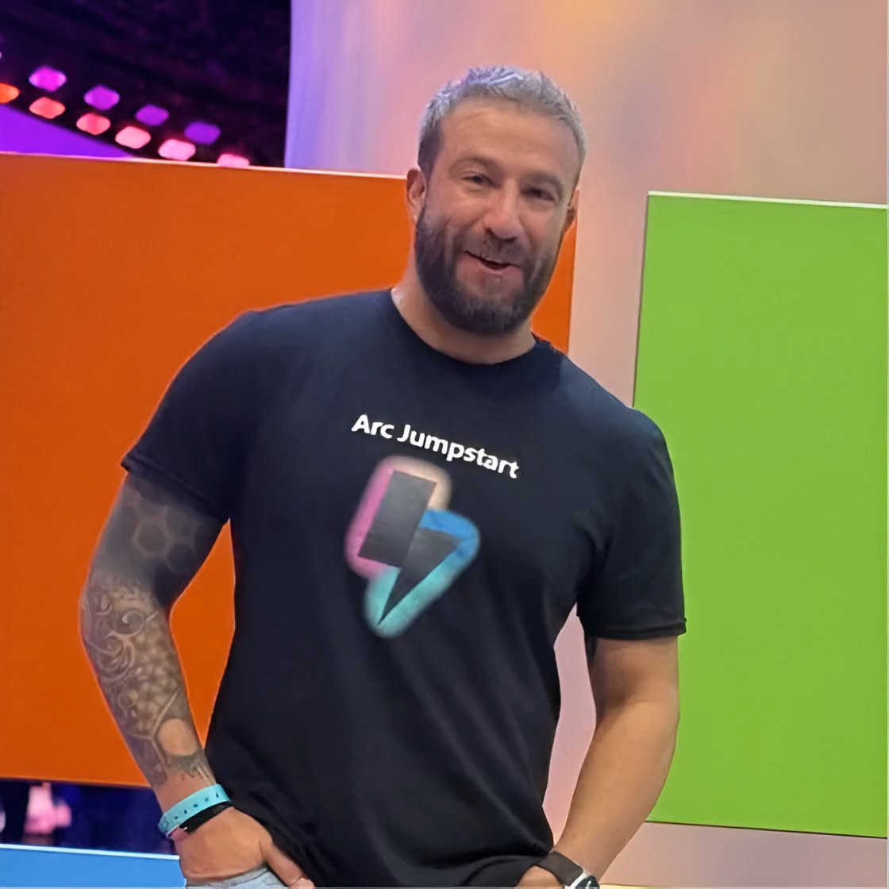
Azure Lunch and Learn
Entra Suite: The Good, The Bad, and The Ugly
Microsoft Certified | Azure & Microsoft 365 Security Architect | Cloud Infrastructure Specialist www.linkedin.com/in/shaunhardneck
Blog link: www.thatlazyadmin.com

